Slide 1

Government for Sale
The Crisis of Money in Politics
Aquene Freechild
Director, Democracy Is For People Campaign
Public Citizen

Slide 2
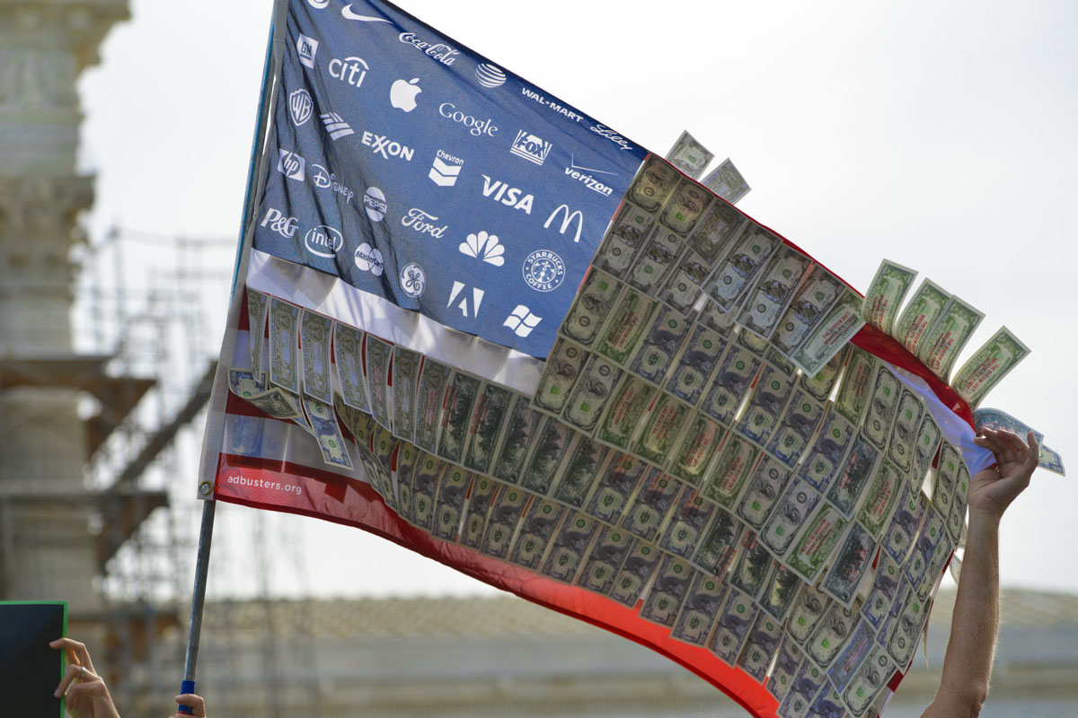
Big Money in Elections
Is Subverting Democracy
The 2012 election was the most expensive in history, costing more than $6 billion.
There is 3x more secret spending in the 2014 elections thus far, than there was at this time in the 2012 presidential election cycle.
Democracy is supposed to be of, by and for the people – but current gov’t serves wealthy first.
To be elected, one must rely on big donors and fear their wrath.
Response: Democracy Movement is growing
Notes:
Business interests rule, why has this gotten so much worse of late?

Slide 3
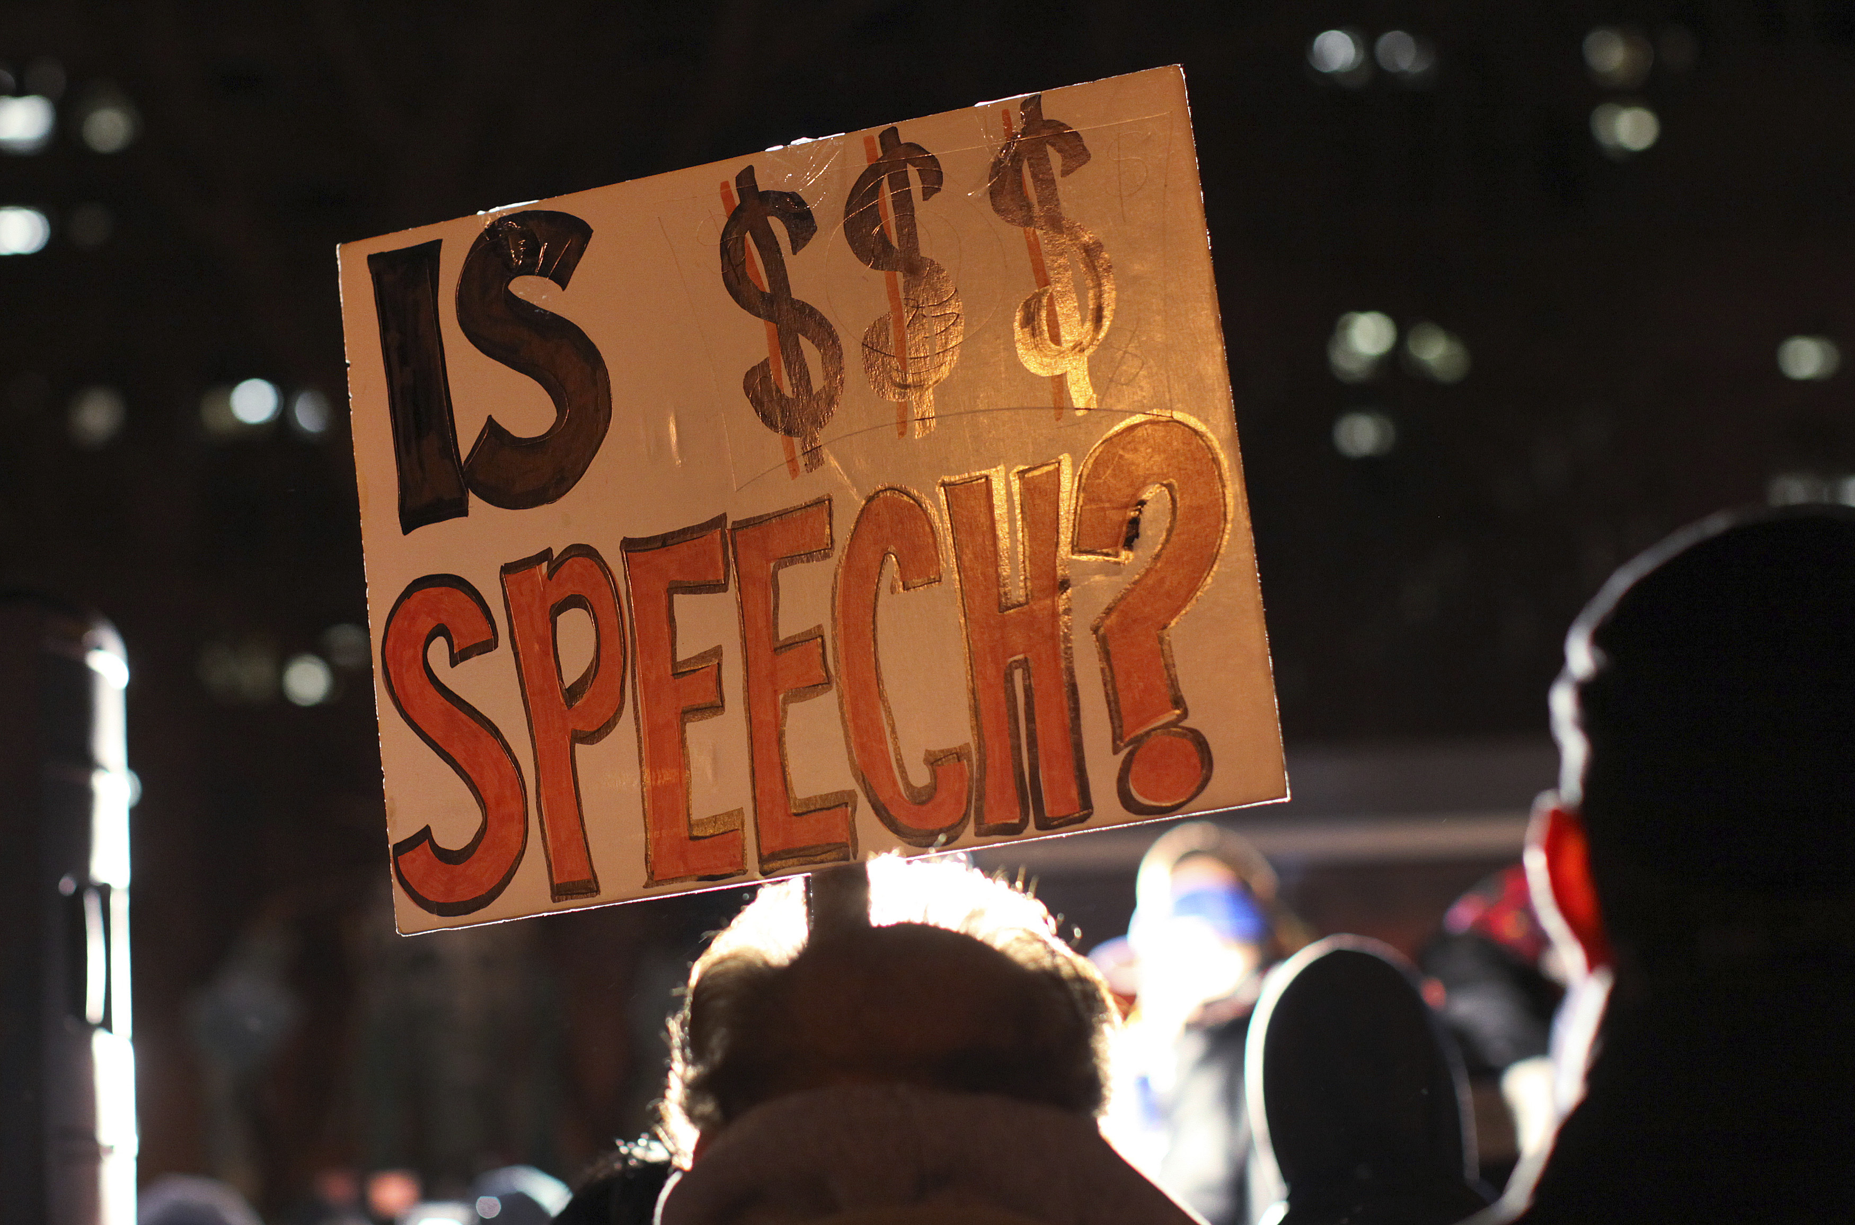
Citizens United v. FEC
The Court ruled: Corporations and unions have the right to “speak” in elections as long as they don’t coordinate with candidates (Buckley v. Valeo ruled that spending money is elections is speech)
Now corporations are free to spend unlimited amounts in elections, Speech Now ruling followed freeing individuals to do the same.
Ruling wildly unpopular across party lines.
Response? 550 cities and towns, 16 states call for a constitutional amendment,
Notes:
Broke with nearly 100 years of law banning corporate spending in elections, inherently corrupting.

Slide 4
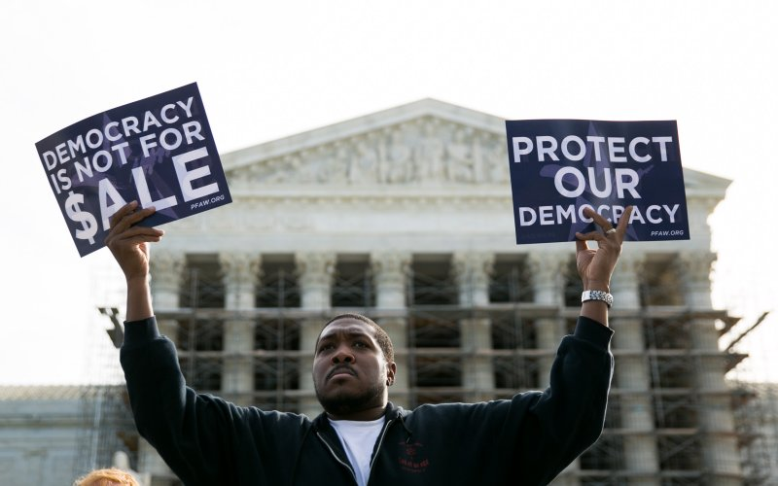
McCutcheon v. FEC
McCutcheon’s Claim: That the $123,000 aggregate limit on a person’s right to donate to federal campaigns violate their first amendment rights
Result: the Supreme Court raises the cap and narrowly defines corruption as out and out bribery.
About 1200 people spent even close to $123,000 in 2012
Now the limit has been raised to nearly $6 million
What does it mean? Just 350 people can easily fund an entire election to govern a country of 350 million people.
151 protests in 41 states the day of the ruling.

Slide 5
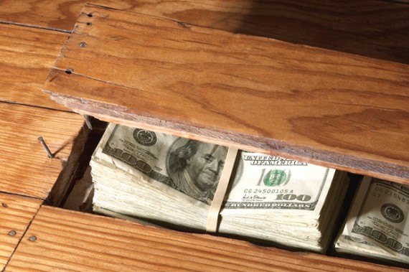
Secret/Dark Money
Sham non-profits sprung up after Citizens United to spend money in elections without disclosing their donors
Battle about the IRS “discriminating” against conservative non-profits set up for this purpose.
Clearer law, functional FEC needed

Slide 6
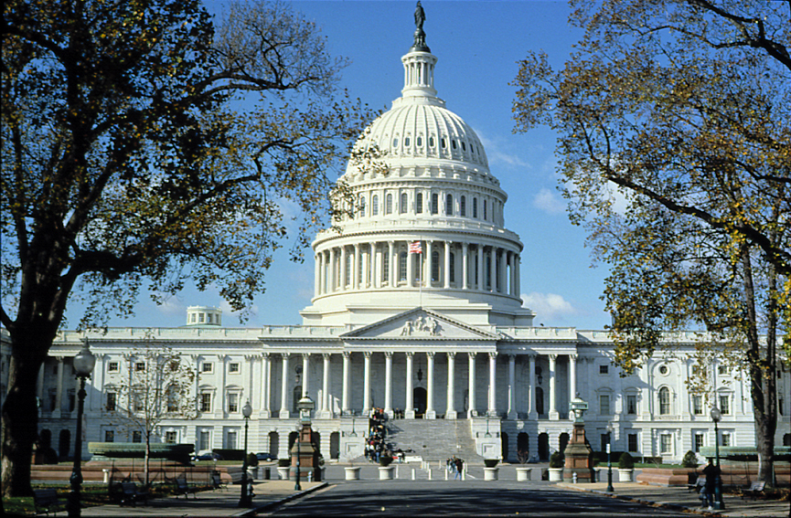
Real Solutions
Disclosure: make sure the public knows where the money is coming from, ‘stand by your ad’
Amendment: would allow the government to limits spending in elections – imagine!
Public Financing: using matching public funds to finance elections so that candidates can afford to/are rewarded for spending time with small donors and voters.

Slide 7
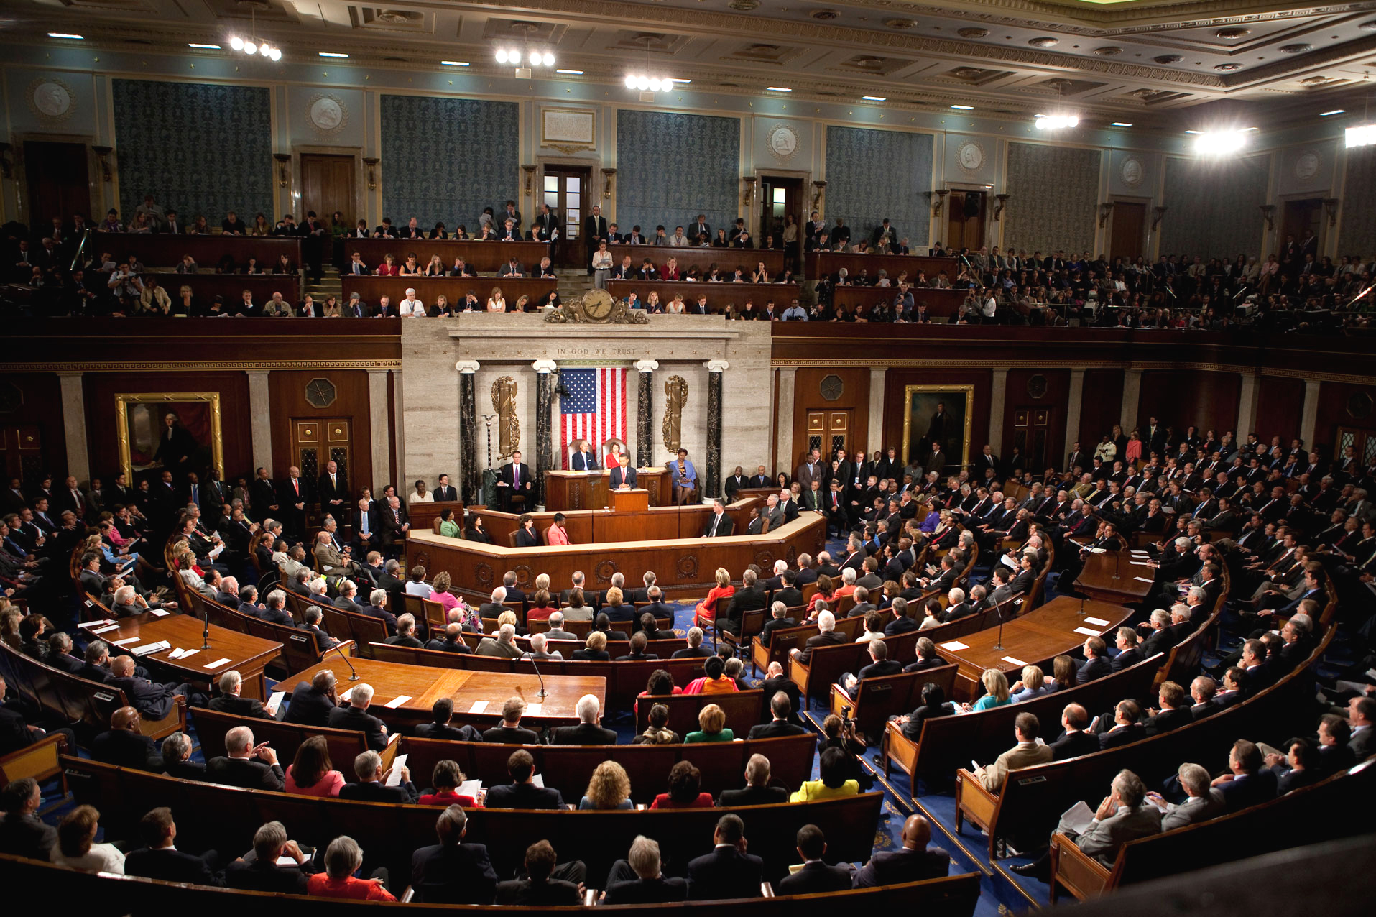
How to Pass an Amendment
To pass:
  2/3 of both Houses of Congress must approve
  3/4 of states must ratify
Udall Amendment: Would allow the federal government and states to regulate money raised and spent in elections.

Slide 8

Current Progress
Hearing for an amendment to overturn Citizens United and McCutcheon
  On June 3rd 2014 the Senate Judiciary Committee held a hearing on the proposed amendment
  Result of McCutcheon rallies and grassroots work
  The Senate will vote on the amendment this year
People’s Pledge
  Inspired by the race between Elizabeth Warren and Scott Brown in MA
  Reduced outside spending on behalf of candidates

Slide 9
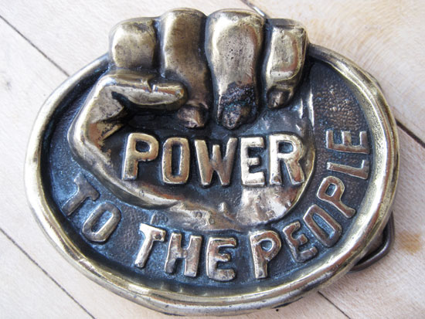
How YOU can get Involved!
DemocracyIsForPeople.org
  Sign the petition for a constitutional amendment!
  Find out if you Senator is a co-sponsor – thank them or ask them to stand up for democracy.
  Help pass a resolution calling for an amendment in your town.
PeoplesPledge2014.org
  Ask your local candidates to agree together to stop outside spending on their behalf.
Notes:
Can’t waste a day, this is not something that non-profits or just getting an anti-corruption super PAC can fix, need people doing deep organizing to win this fight.

Slide 10

Questions?
Aquene Freechild
202-588-1000
afreechild@citizen.org
www.DemocracyIsForPeople.org

